Slide 1


Slide 2

The problem?
- No similar applications out there that provided the same service
- Parents needed to have easy access to information
- Cutbacks at hospitals lead to the need for parents to become more independent

Slide 3
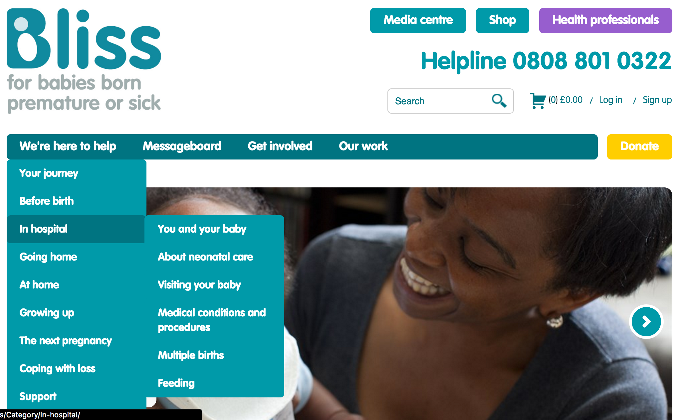
The problem?
Bliss website

Slide 4


Our solution?
Mobile Operating systems
CMS

Slide 5
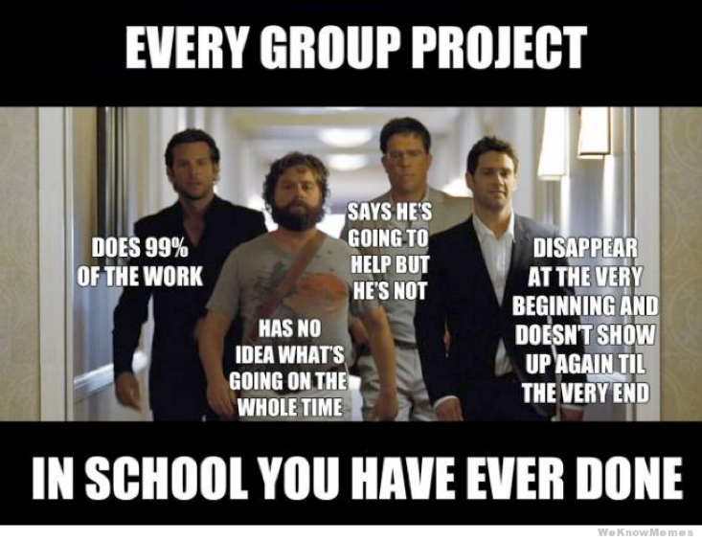
Group management

Slide 6


Group management
- agile methodologies
- sprints
- kanban
- burn-down charts

Slide 7
client focus
- we had a real client
- Gathering requirements are just like what we’re taught in lectures
- Learn to build client relationships in meetings
- Ethics documents
- collecting sensitive data
- Required for user testing

Slide 8
Design
- used by real people
- focused a lot of our initial time on this
- went through multiple iterations with the client

Slide 9
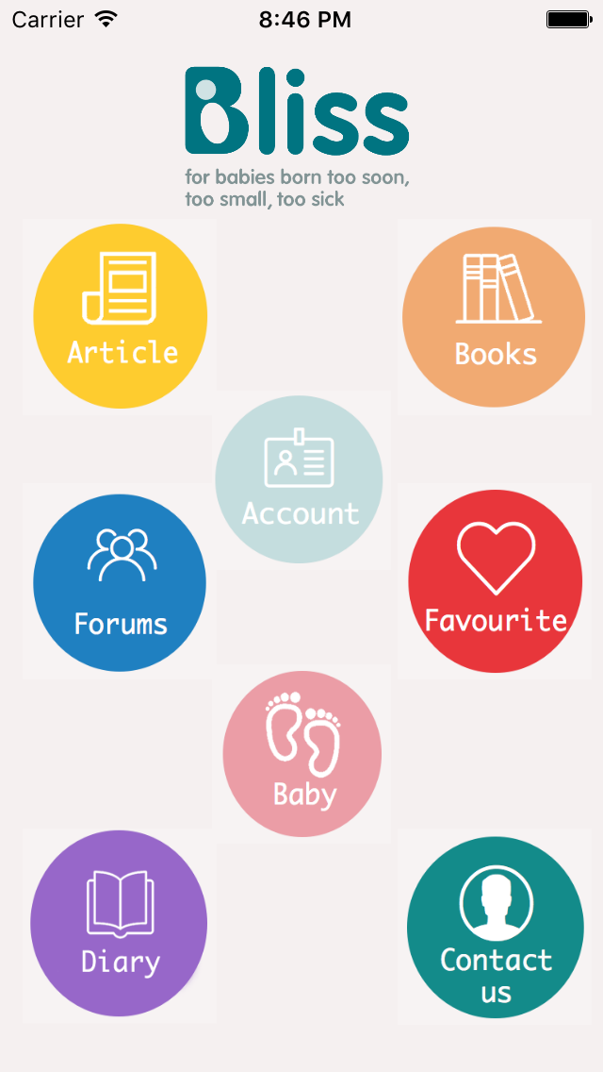
Mainscreen
Choose one of the many options on the main screen to test the versatility of our app

Slide 10
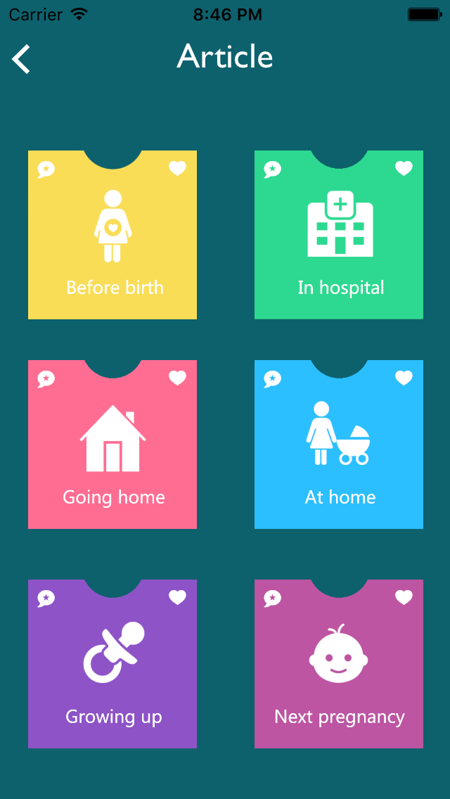
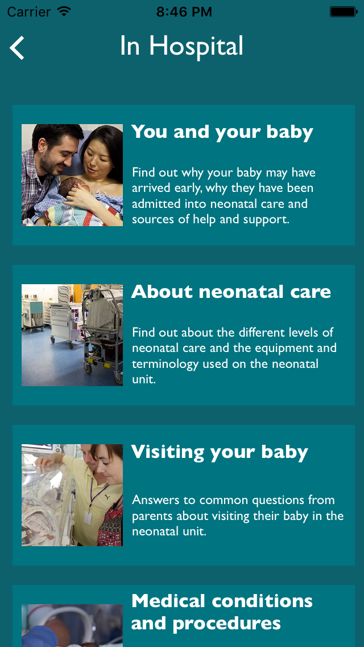
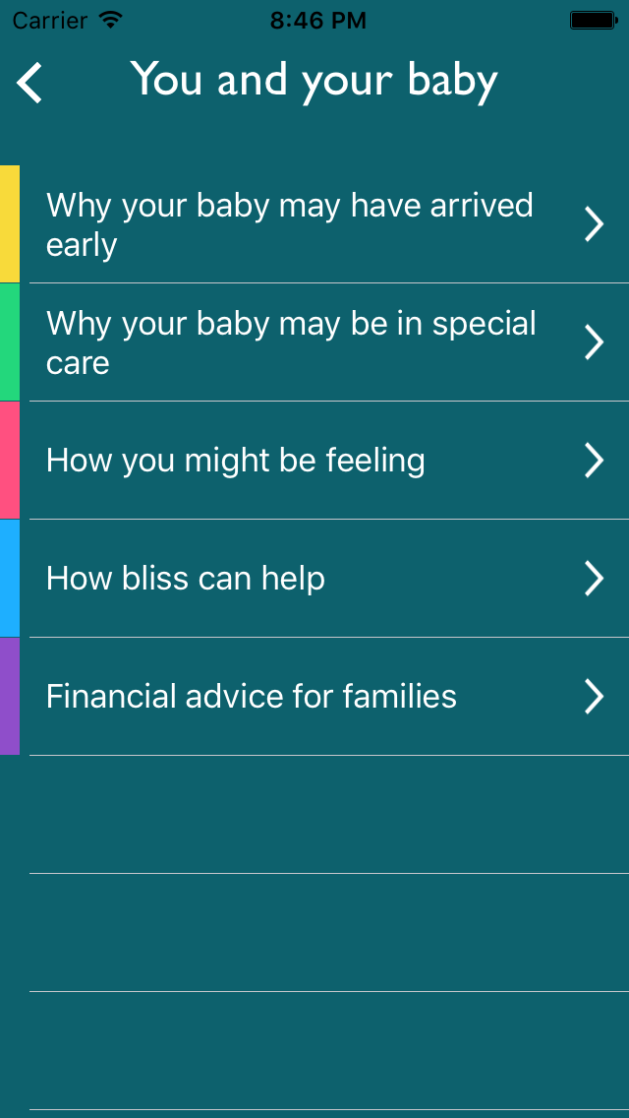
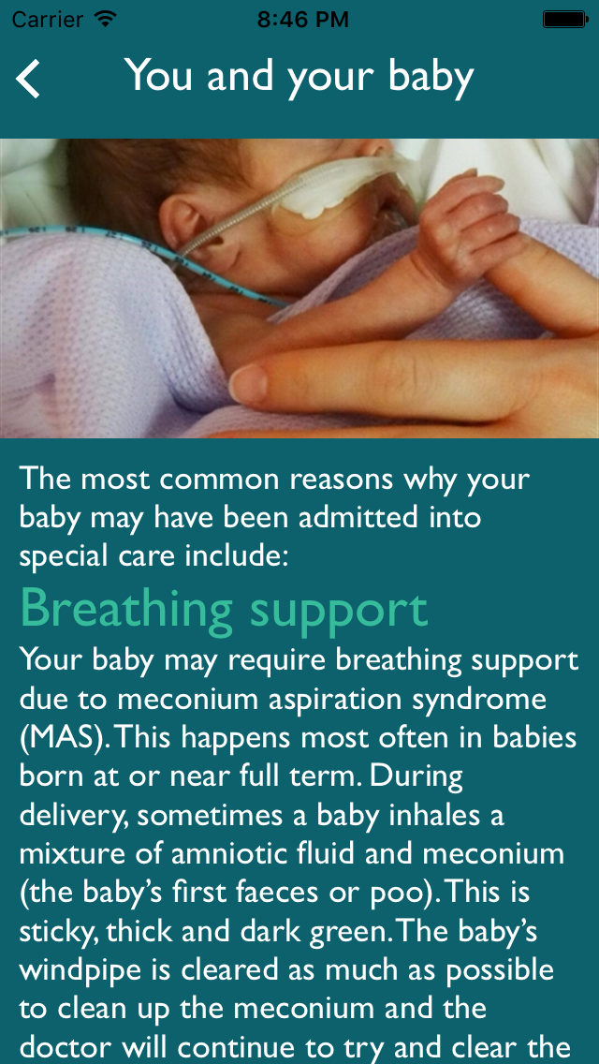
Articles
check out some articles. beautifully categorised and stunningly presented. Like an article? why not favourite it for easy access later on

Slide 11
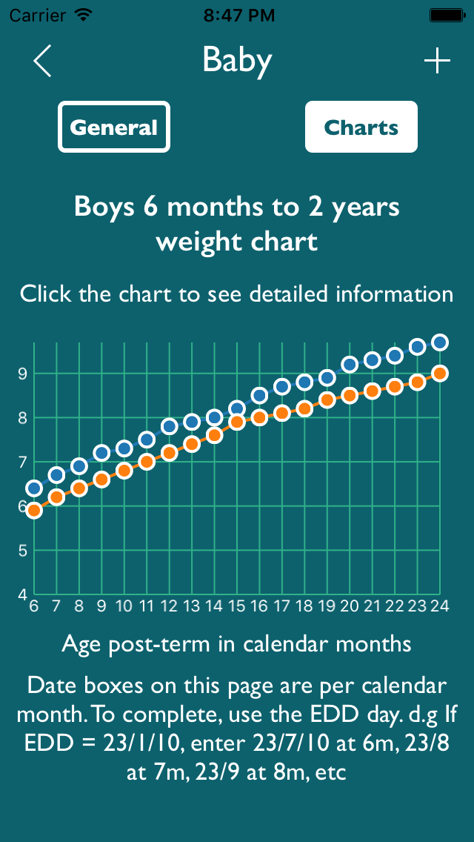
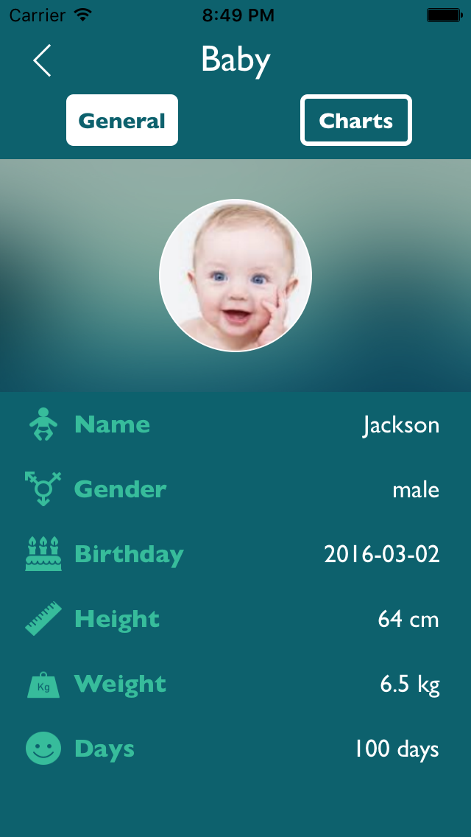
about the baby
check or add your baby’s info, compare their weight to the average to keep up to date with his/her well being

Slide 12
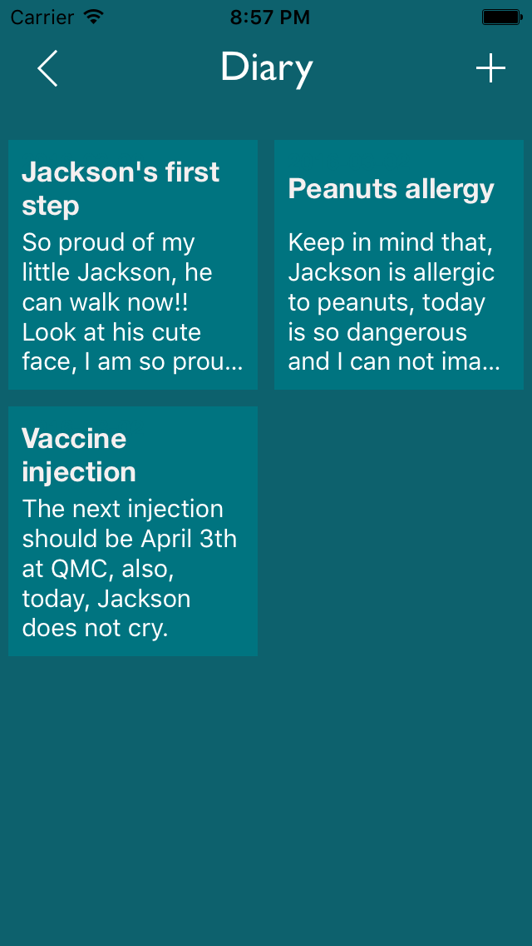
diary
record your little ones special moments, allergies and general medical condition. so you’re never left stumped looking for that piece of paper you wrote it on

Slide 13
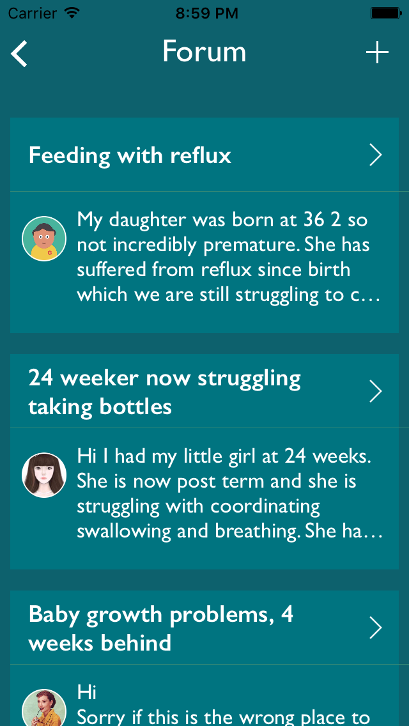
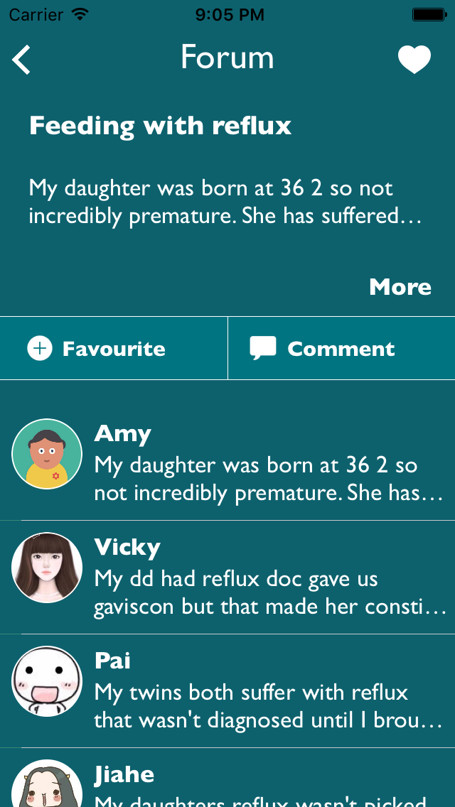
forum
interact with other parents. share tips and recipes. offer support and guidance all in one place

Slide 14


Success or failure?

Slide 15
Q & A

